Slide 1



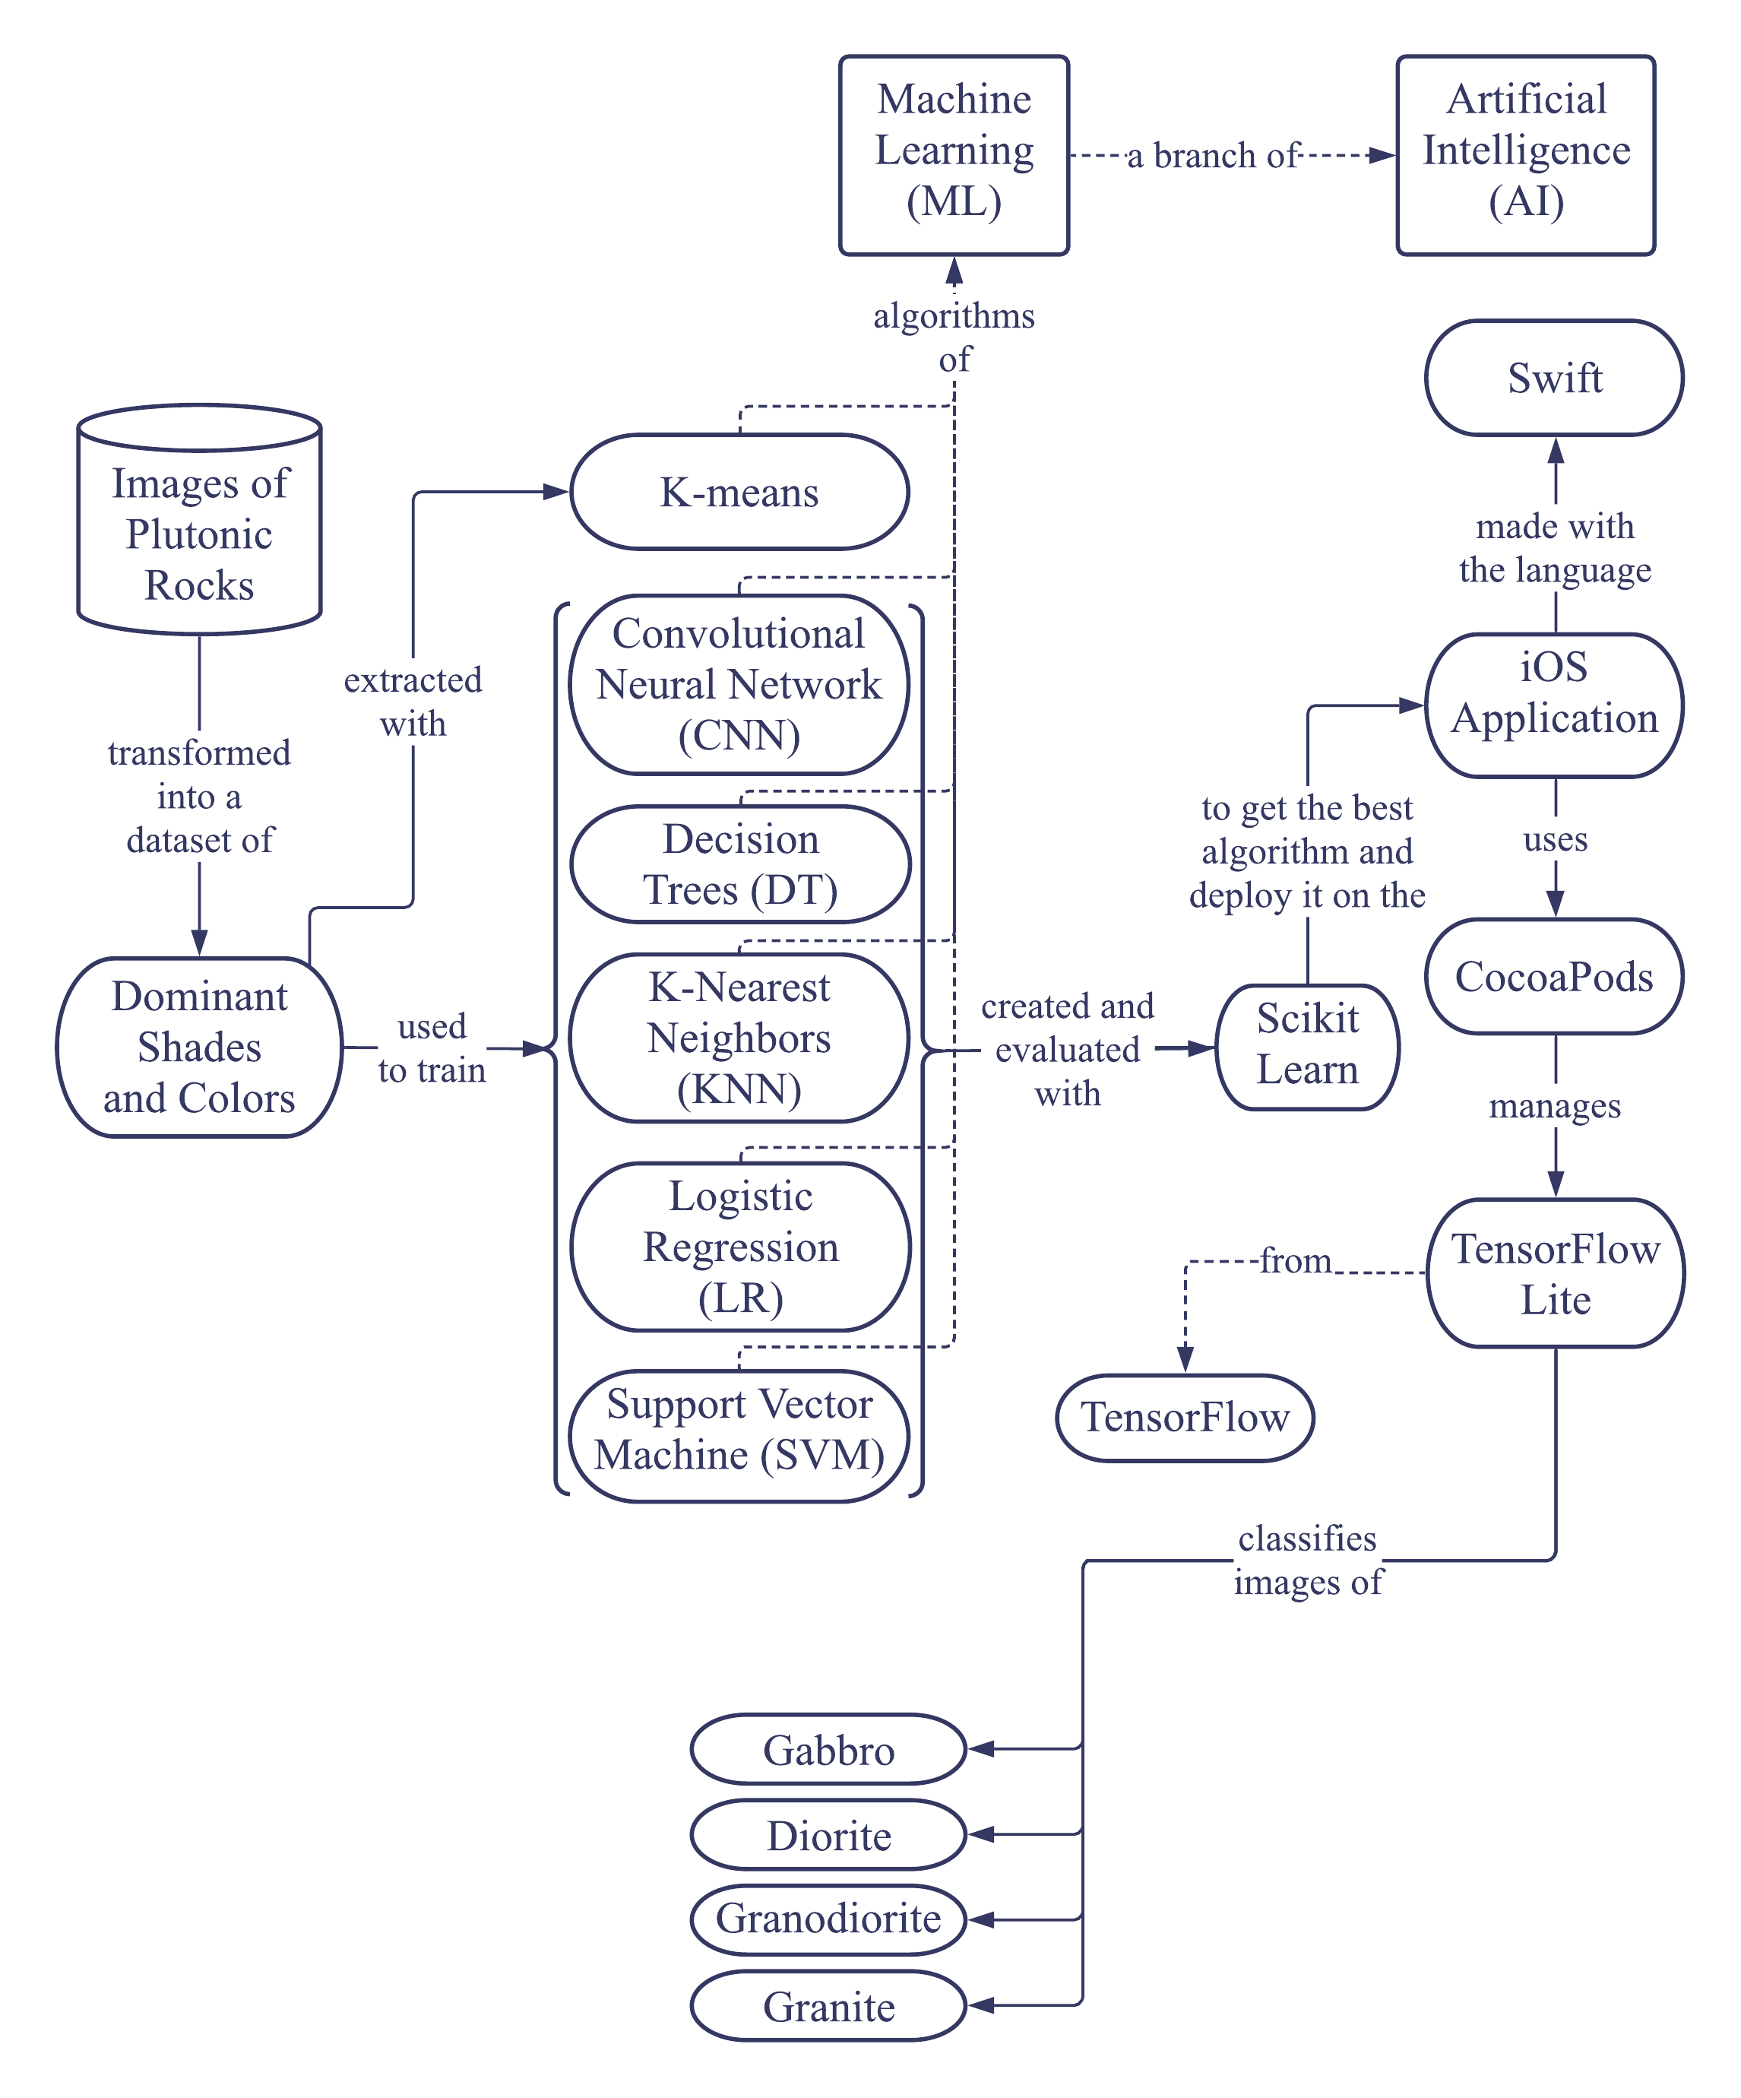
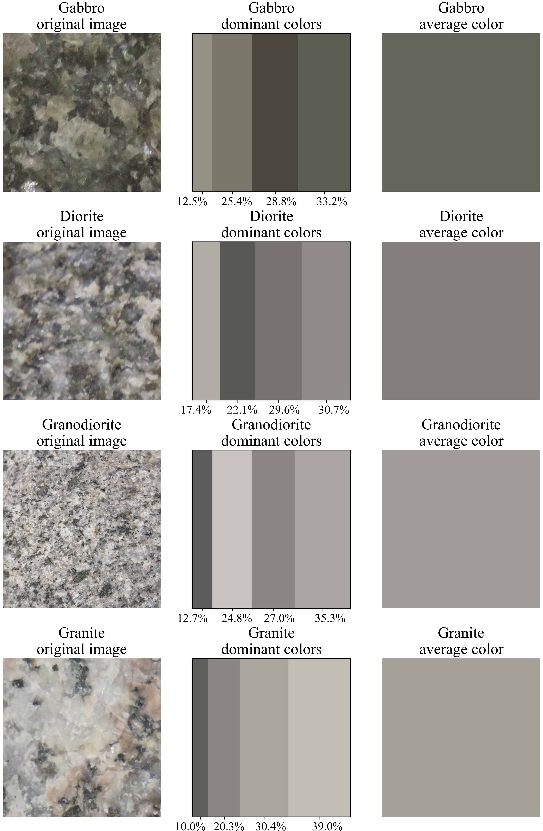

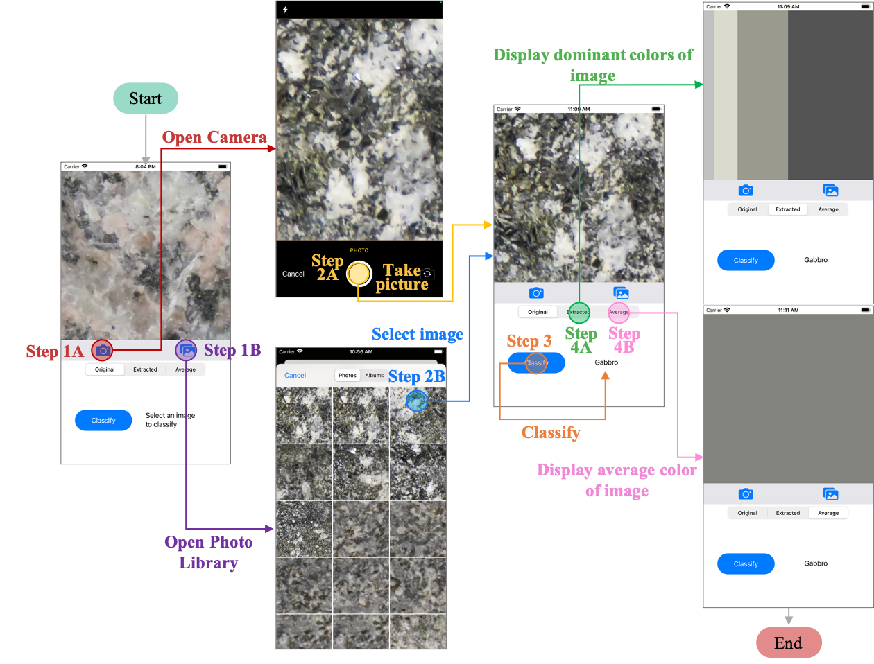

AUTOMATIC CLASSIFICATION OF PLUTONIC ROCKS WITH MACHINE LEARNING APPLIED TO EXTRACTED SHADES AND COLORS ON iOS DEVICES
Sarah Hernández¹; Germán H. Alférez, Ph.D.¹; Benjamin L. Clausen, Ph.D.² ³; Ana M. Martínez, Ph.D.²
¹ School of Engineering and Technology of Montemorelos University; ² Department of Earth and Biological Sciences of Loma Linda University; ³Geoscience Research Institute
1170469@alumno.um.edu.mx; harveyalferez@um.edu.mx; bclausen@llu.edu; anmartinez@llu.edu
INTRODUCTION
Lightness and color are properties used for the classification of plutonic rocks; however, these attributes can be difficult to describe because perceived rock colors depend on the observer’s experience [1]. Moreover, although the classification of plutonic rocks can be done using data from various instrumental techniques, these approaches tend to be expensive and time-consuming. Also, there are no works presenting the implementation of machine learning on iOS devices. This research extracts dominant shades and colors from plutonic rock images to train several machine learning algorithms and deploy the best model on an iOS application for the automatic classification of four classes of plutonic rocks in order from darker to lighter: gabbro, diorite, granodiorite, and granite.
RESULTS
The best results during validation were for the model generated using KNN trained with the four dominant colors in the CIELAB format (Fig. 3). These results are better than those obtained in [3,4] in which feature extraction was applied to classify mineral samples. Moreover, they are similar to other works [5,6,7,8,9] in which machine learning was applied for rock classification. In addition, the training time of 0.068 seconds, the execution time of 339.87 milliseconds, and the file size of 0.018 MB obtained in this approach were better compared to [5, 6, 7]. The model generated with KNN was deployed in the application (Fig. 4).
CONCLUSIONS
The dominant colors approach can be useful in classifications where color is important to differentiate images. CIELAB color format is an excellent option to do this. In addition, feature reduction can be applied when a quicker and lighter solution is needed. Although the images are not as many as in other papers, the results are very promising and can be improved with techniques such as data augmentation and extracting crystal shapes from rock images in addition to the dominant colors.
METHODOLOGY
We used pictures of plutonic rocks that had been classified using petrography and chemistry data to train the models [2]. See the underpinnings of our approach in figure 1.
1. Color extraction
The dominant colors of plutonic rock images were extracted with the K-means algorithm by grouping the image pixels according to the RGB and CIELAB color spaces (Fig. 2).
2. Model training
The data of the four dominant colors in 283 images were used to create and evaluate several machine learning models with the following algorithms: Logistic Regression (LR), K-Nearest Neighbors (KNN), Decision Trees (DT), Support Vector Machines (SVM), and a Convolutional Neural Network (CNN). The experiments were executed first with the dominant colors in RGB and then in CIELAB.
3. Deployment of the iOS application
The best model was deployed after validation on an iOS application that classifies the extracted colors in new images of the four rock types.
Figure 2. Sample rocks with their dominant colors in percentage order and their average color
Figure 1. Underpinnings of our approach
REFERENCES
[1] Natural Resources Conservation Service, “Part 631: Geology,” in National Engineering Handbook, 210-VI, Access date: 12/16/2020, 2012, ch. 4, p. 7.
[2] S. Hernández. (2021) Color-extraction [Source code]. https://github.com/ sarah-hs/Color-extraction/tree/main/Rock-images.
[3] Y. Zhang, M. Li, S. Han, Q. Ren, and J. Shi, “Intelligent Identification for Rock-Mineral Microscopic Images Using Ensemble Machine Learning Algorithms,” Sensors, vol. 19, no. 18, p. 3914, 2019. DOI: 10 .3390/s19183914.
[4] J. Maitre, K. Bouchard, and L. P. Bédard, “Mineral grains recognition using computer vision and machine learning,” Computers & Geosciences, vol. 130, pp. 84– 93, 2019. DOI: 10.1016/j.cageo.2019.05.009.
[5] E. Vázquez and H. Alférez, “Using Deep Learning for Automatic Classification of Plutonic Rocks with Mobile Devices”, 2021.
[6] G. Fan, F. Chen, D. Chen, and Y. Dong, “Recognizing Multiple Types of Rocks Quickly and Accurately Based on Lightweight CNNs Model,” IEEE Access, vol. 8, pp. 55 269–55 278, 2020. DOI: 10.1109/access.2020. 2982017.
[7] G. Fan, F. Chen, D. Chen, Y. Li, and Y. Dong, “A Deep Learning Model for Quick and Accurate Rock Recognition with Smartphones,” Mobile Information Systems, vol. 2020, pp. 1–14, 2020. DOI: 10.1155/2020/7462524.
[8] X. Ran, L. Xue, Y. Zhang, Z. Liu, X. Sang, and J. He, “Rock Classification from Field Image Patches Analyzed Using a Deep Convolutional Neural Network,” Mathematics, vol. 7, no. 8, p. 755, 2019. DOI: 10.3390/math7080755.
[9] G. Cheng and W. Guo, “Rock images classification by using deep convolution neural network,” Journal of Physics: Conference Series, vol. 887, p. 012 089, 2017. DOI: 10.1088/1742-6596/887/1/012089.
Figure 3. Accuracy of the models trained with the RGB and CIELAB dominant colors data
Figure 4. Application workflow

